Slide 1
My Project
By Julian To

Slide 2
Introduction
Creating an Inventory management system
Requires functionality to add, view update and delete customers, products and orders
Adding and deleting individual items from orders.
Created in Java

Slide 3
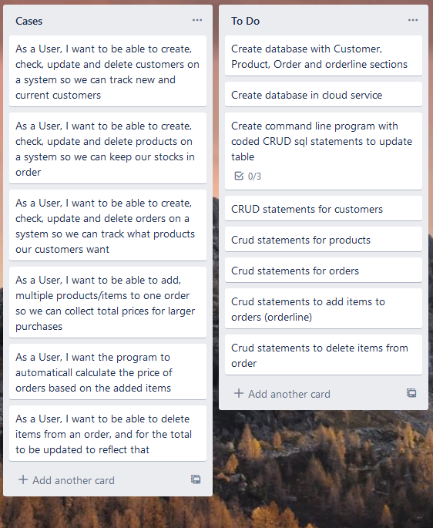
Kanban Board
User Stories and To Do list

Slide 4
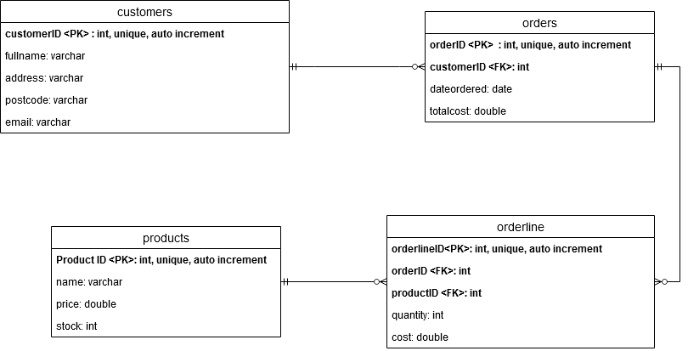
Entity Relationship Diagram

Slide 5
Initialising the Database
Based on the ERD, we can see the need for at least 4 tables in SQL.
Each has a unique tableID as its primary key (unique not null auto_increment).
Orders are one to one with customers.
Orderlines are many to one with products and orders.
Multiple orderlines (items) to single order.

Slide 6
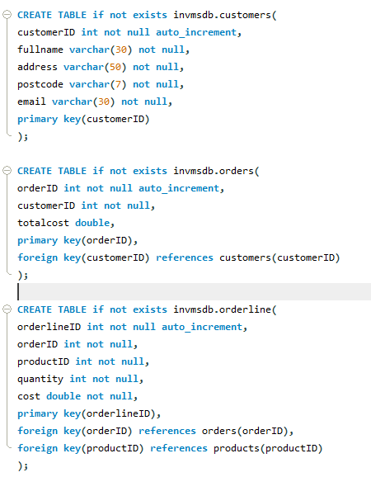
SQL snippet
tableID is a unique, not null, auto_increment integer
Primary key
Double for money based fields
Varchar for any strings

Slide 7


Database: Orderlines
We can see the relationship between the 4 tables, through reading our orders and orderline tables.
Orderlines are tied to a single order.
Creating or deleting orderliness will update the associated orders total

Slide 8
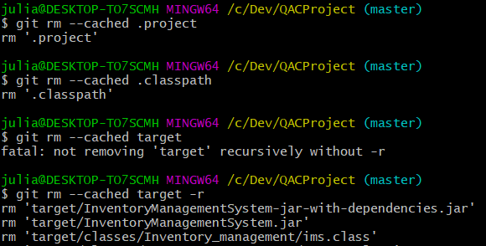
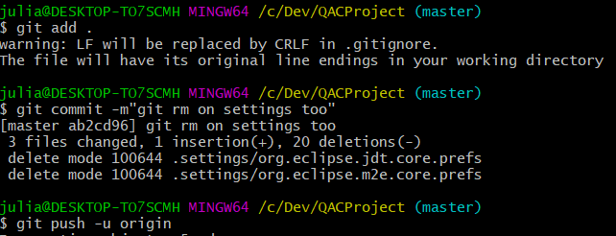

Maven Usage

Slide 9
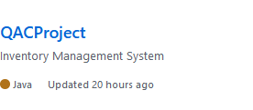
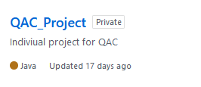
Git
Important to start project in eclipse as a maven project to get properly generated pom.xml and folder/file structure.
Due to new project being used, was no longer able to use old repository for new commits.
Cleaning up git repository by using gitignore file and git rm command to clean the cached files still in the repository

Slide 10
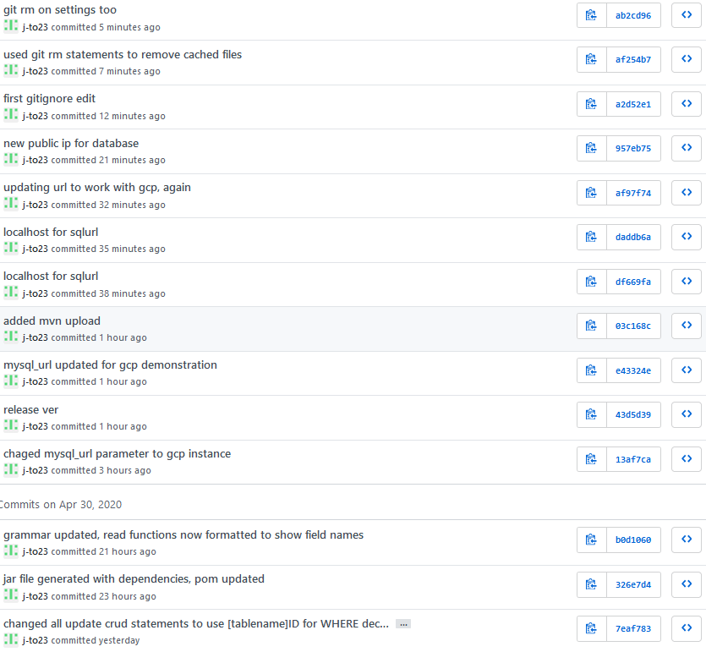
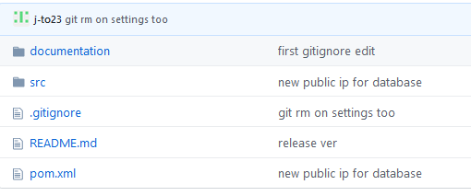
Git

Slide 11
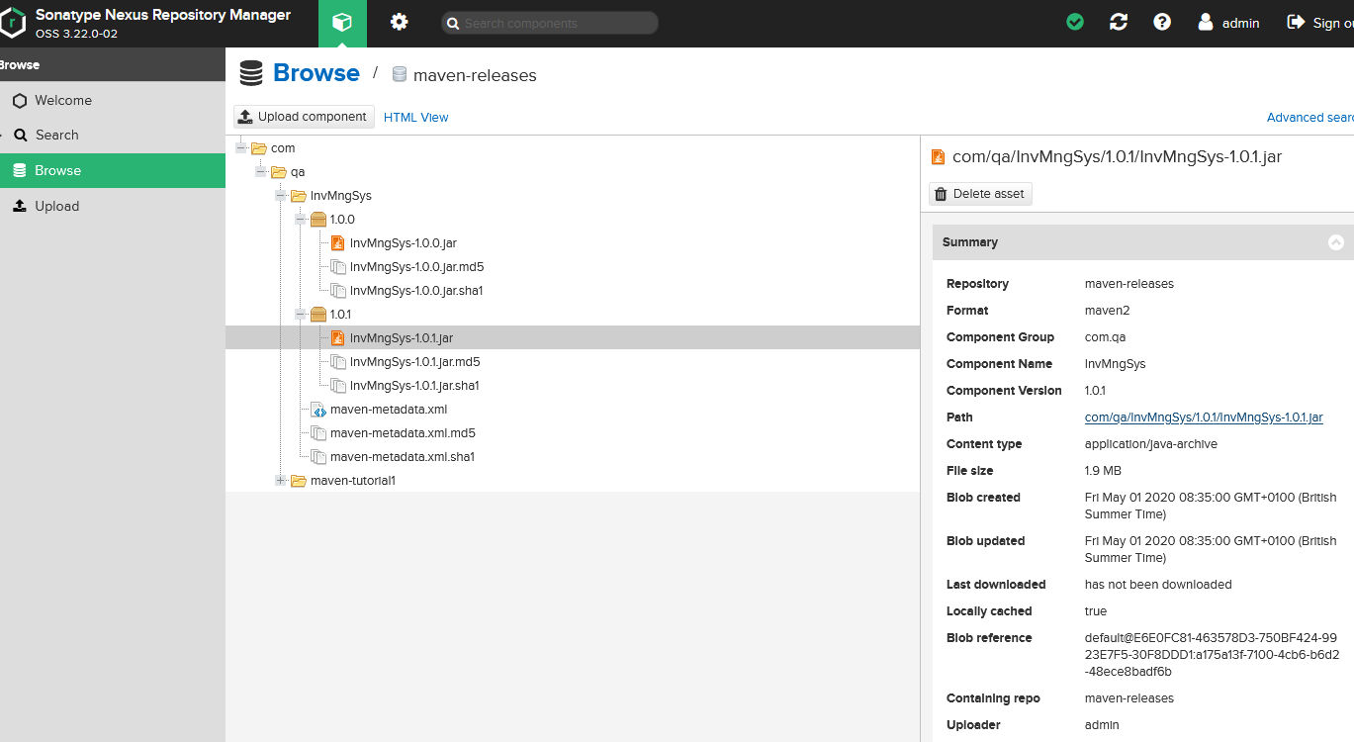
Nexus

Slide 12
Demonstration
Demonstration of program on command line

Slide 13
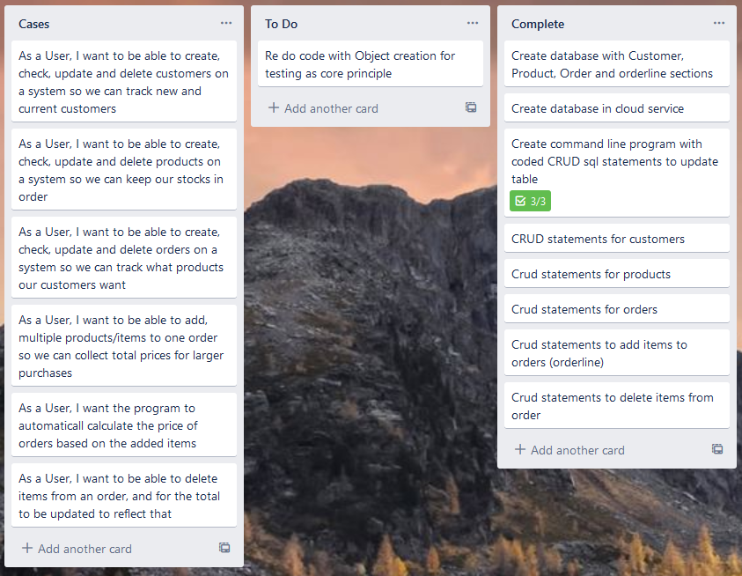
Review
Java programs should be built with TDD in mind.
Objects
Maven
Testing needs to be implemented to show code functionality under a variety of circumstances
Using Mockito and junit generally dependant on better implementation of objects into my code
IMS does function, performs all functions as requested in Domain of specification

Slide 14
My Journey
General Workflows
Daily scrum meetings to go over previous material and future plans.
SQL
New system to me, but I’ve picked up the SQL statements fairly quickly and am comfortable implementing them in code
Java
New language to me, with only the cloud academy training before starting as experience. While I did struggle with this project, I have a much better understanding and appreciation of the importance of test driven development.
TDD needs to influence my coding from the beginning of a project
Maven
Using Maven is also a new skill, understanding its importance when using java has been a big part of my learning

Slide 15
My Journey
Git
Uploading to Github and using git commands is also new to me, but understanding its usage has been quite beneficial and I have a good appreciation of its usage.
Nexus
Nexus as a repository of artifact versions has been beneficial for when comparing functionality between large changes to code
Cloud Services (GCP)
Understanding the usage of VMs and its usage in future projects that require collaboration between multiple developers

Slide 16
Thank you for listening
Any questions?

